Slide 1
Smash Wireless
Elena Finley, Jacques Guillory, Brandon Good

Slide 2
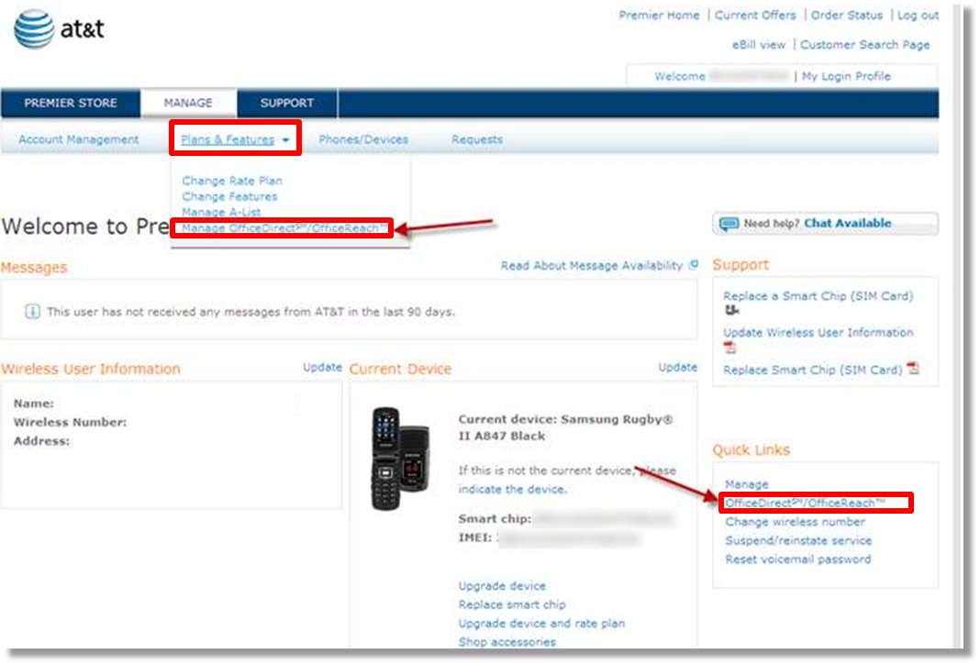
Inspiration

Slide 3
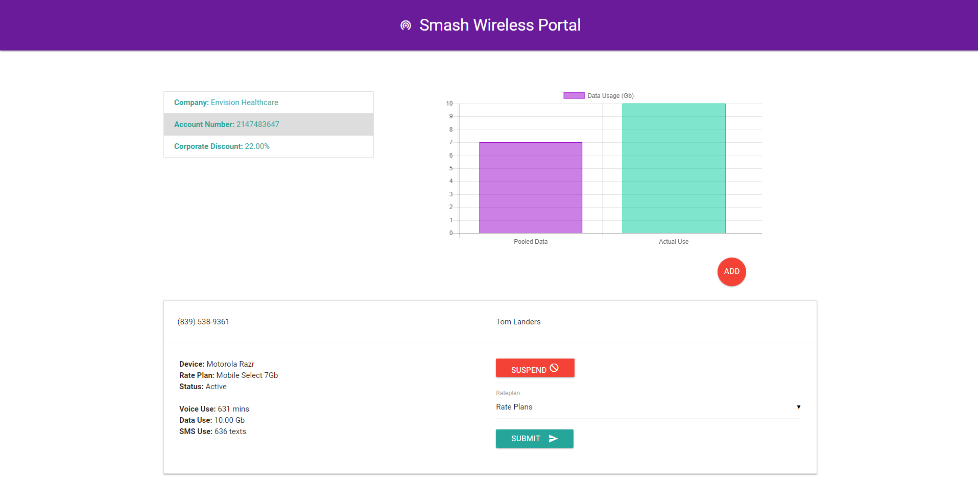
Our Solution

Slide 4
Libraries Used
Class Software
New Software
Node
Express
MySQL
Sequelize
Body-parser
Handlebars
Path
Materialize
Chance.js
Chart.js

Slide 5
Tech Demo
Link: https://stark-plateau-61369.herokuapp.com/

Slide 6
Future Development
Suspend lines
User sign-in
Multiple device types
Export Data to Excel
Device Selection and Shipping

